Slide 1
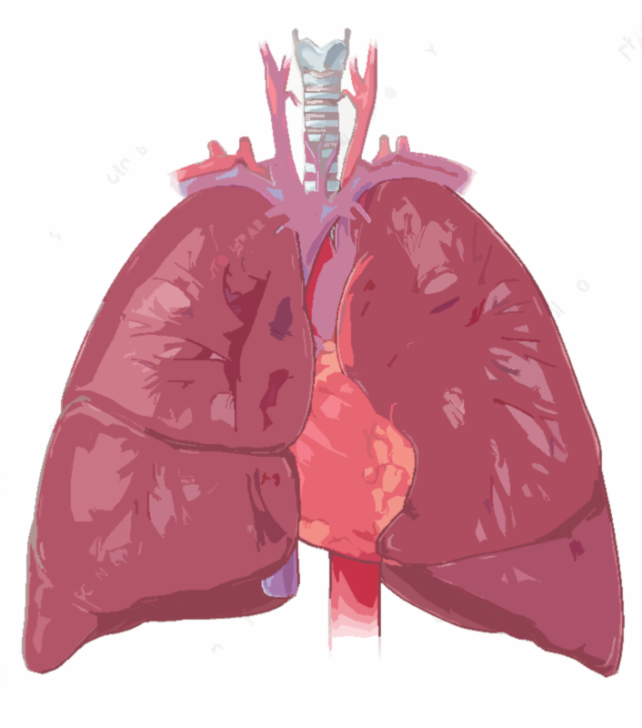
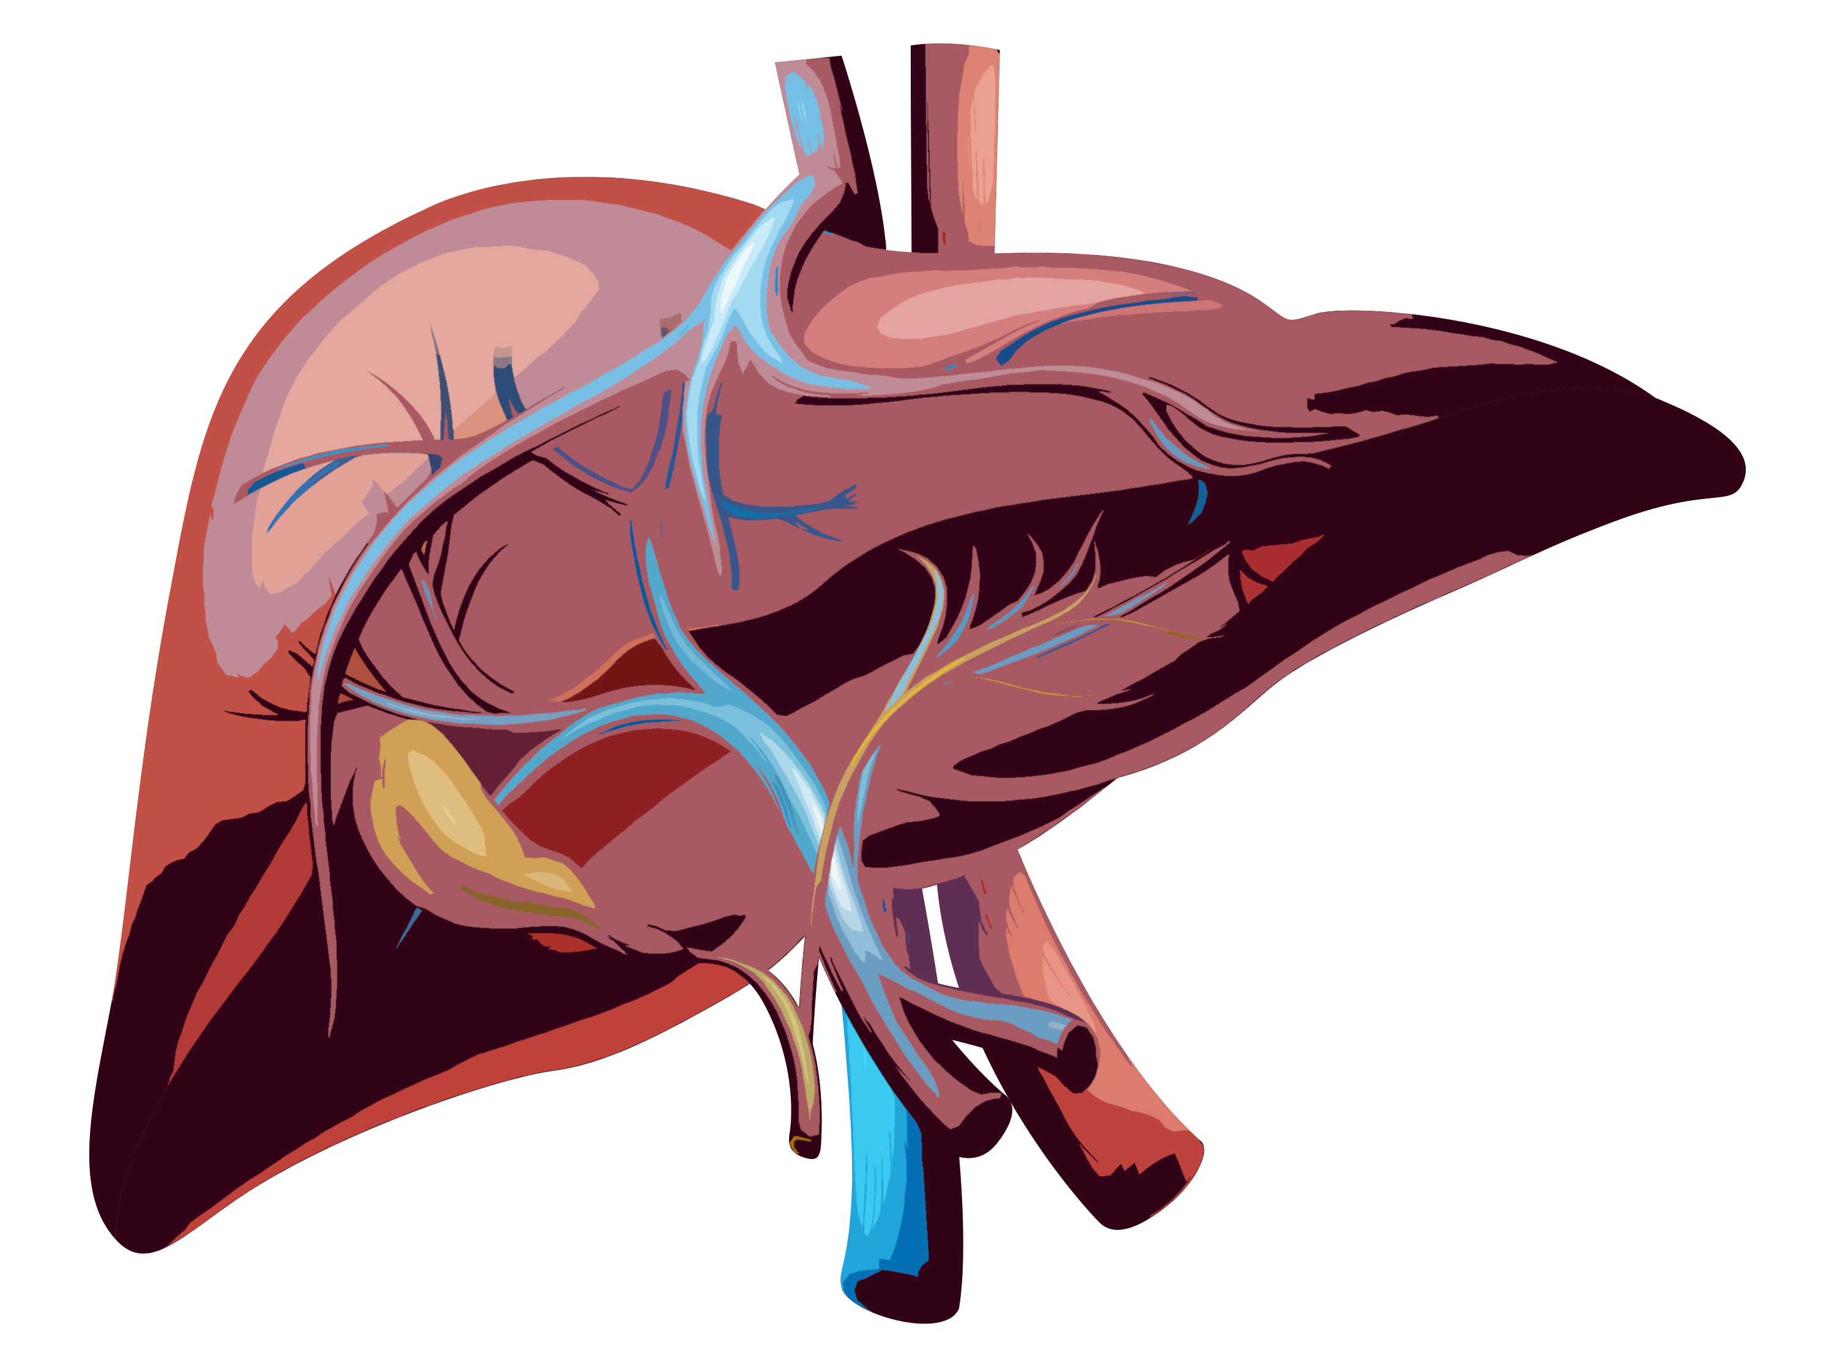

Liver and Lungs
Hepatopulmonary and Portopulmonary Syndromes
Mohammad Almeqdadi, MD
Transplant Hepatologist and Gastroenterologist
Assistant Professor of Medicine and Surgery

Slide 2
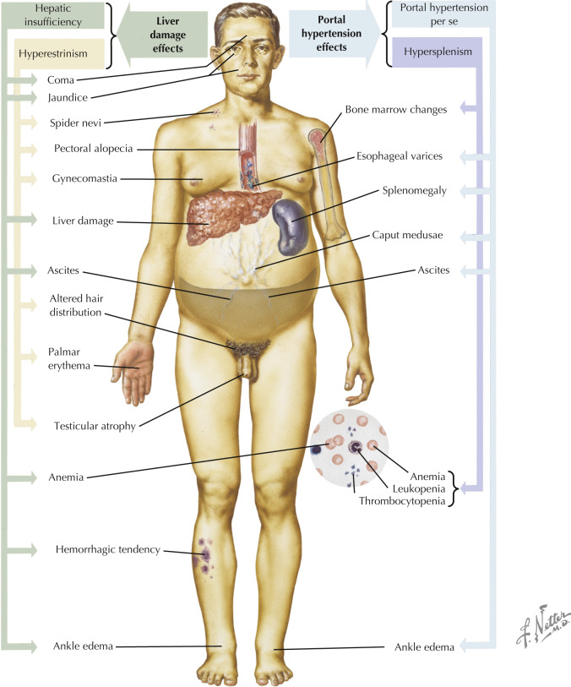

Slide 3
Case Presentation
A 54-year-old man with history of alcohol-related cirrhosis complicated by portal hypertension (ascites and variceal bleed in the past s/p banding and currently on carvedilol), who presents to your clinic with dyspnea.
His shortness of breath improves when he lays down
His pulse-ox decreases when he sits up
What do you call the above signs?
What’s going on?

Slide 4

Platypnea-Orthodeoxia
Ancient Greek Language
Platus: flat
Orthos: upright
Pnea: breath

Slide 5
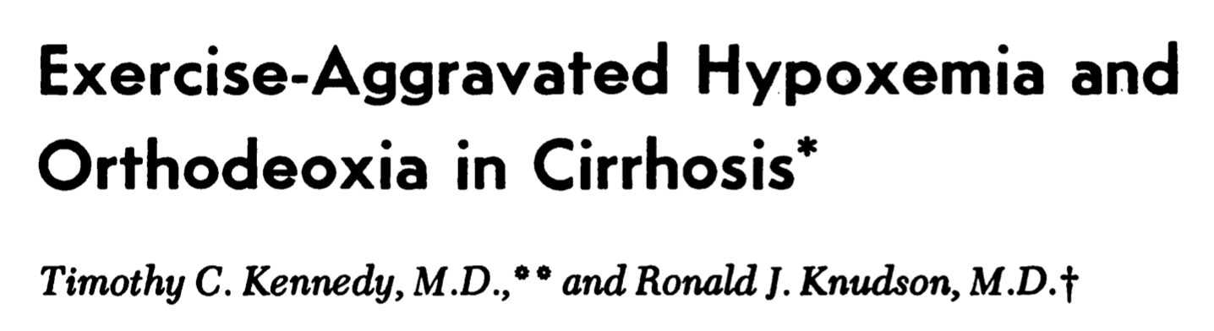
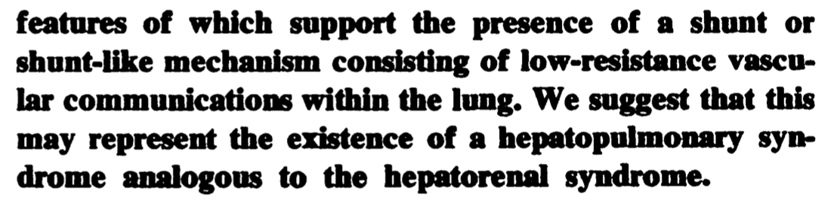
Hepatopulmonary Syndrome
HPS definition is a triad of:
  Hepatic dysfunction or Portal hypertension
  Widened A-a oxygen gradient on room air
  Presence of intrapulmonary vasodilation (IPVD)
The term hepatopulmonary syndrome was coined in 1977
Chest. 1977 Sep;72(3):305-9

Slide 6
Epidemiology
As many as 40-60% of cirrhotic patients may have detectable intrapulmonary vascular dilation (IPVD)
Up to 30% will develop impaired oxygenation due to IPVD

Slide 7
So what’s the pathophysiology behind HPS?

Slide 8
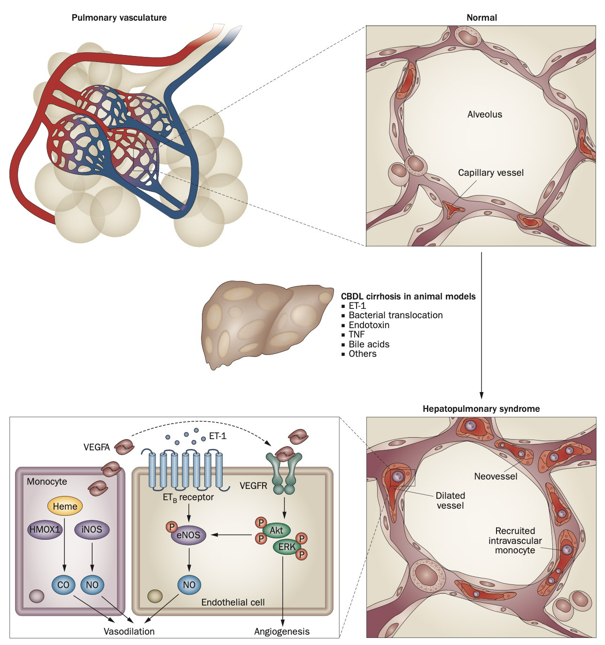
Nat Rev Gastroenterol Hepatol. 2012 Sep;9(9):539-49

Slide 9
Cirrhosis ---magic--> Nitric Oxide (NO) ---magic---> HPS
Nat Rev Gastroenterol Hepatol. 2012 Sep;9(9):539-49

Slide 10
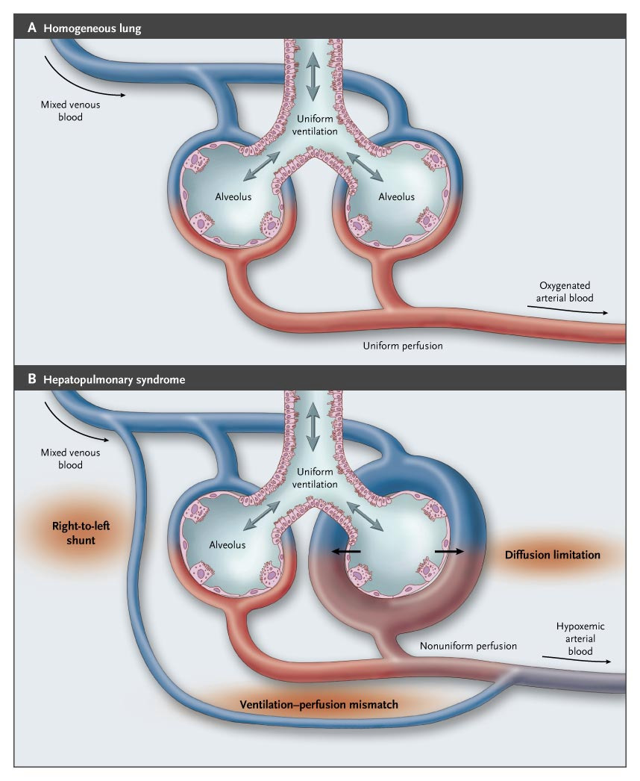
N Engl J Med. 2008 May 29;358(22):2378-87.

Slide 11
N Engl J Med. 2008 May 29;358(22):2378-87.

Slide 12
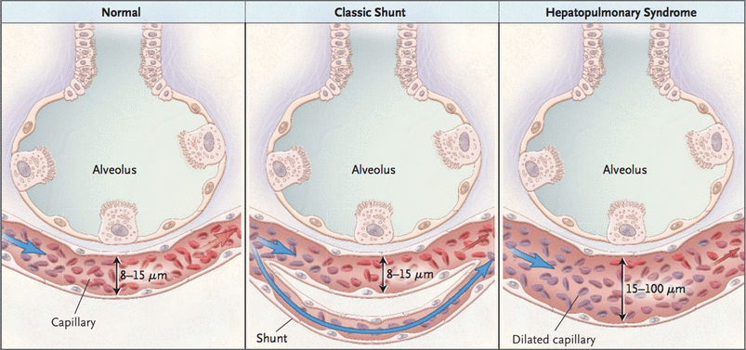
Pediatr Surg Int. 2017 Dec;33(12):1335-1340

Slide 13
Types of Hepatopulmonary Syndrome
Type I: diffuse pulmonary vascular dilatations at the precapillary level close to the normal gas exchange units of the lung
Type II: more discrete, localized dilatations and are actually large arteriovenous communications distant from the gas exchange units

Slide 14
Type I
Type II
N Engl J Med. 2008 May 29;358(22):2378-87.

Slide 15
Do we care if it’s type I or II?
..or is this just for medical student pimping and board exam purposes?

Slide 16
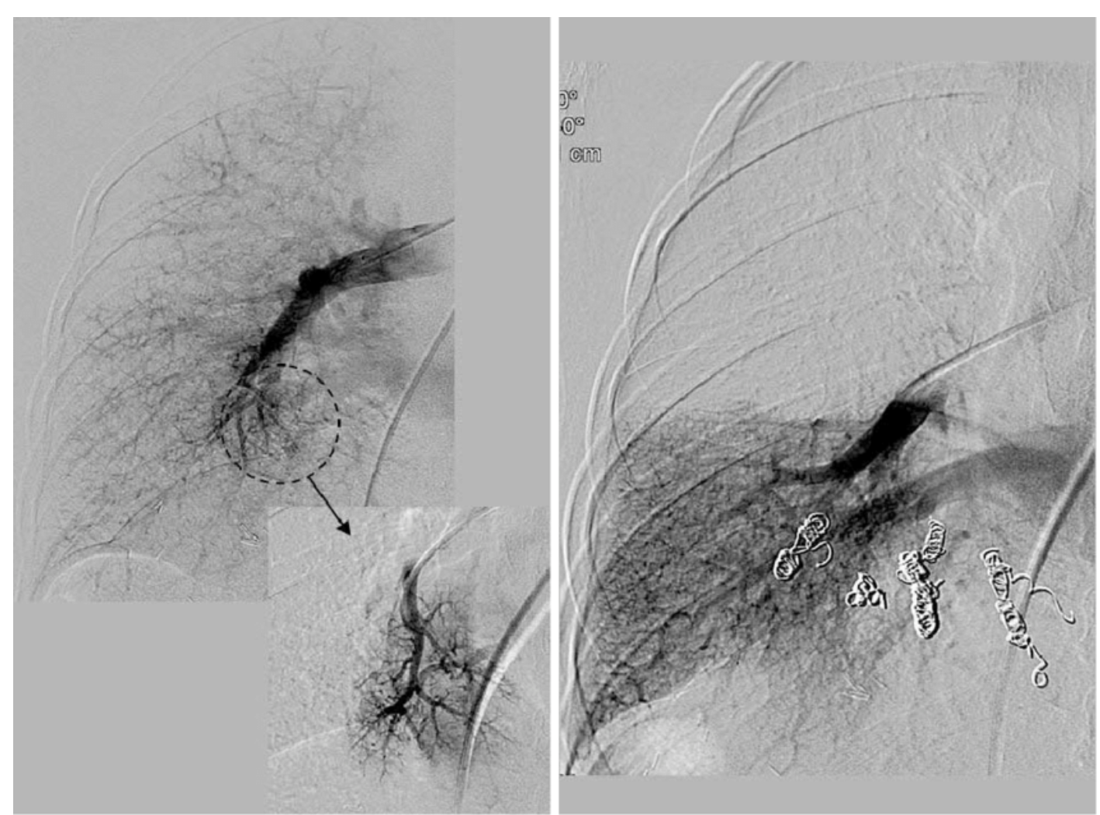
Korean J Radiol. 2010 Jul-Aug;11(4):485-9.

Slide 17
Does hepatopulmonary syndrome respond to supplemental oxygen?

Slide 18
Does hepatopulmonary syndrome respond to supplemental oxygen?
Type I does
Type II doesn’t
Type I
Type II
N Engl J Med. 2008 May 29;358(22):2378-87.

Slide 19
So how are we going to diagnose HPS when suspected?

Slide 20
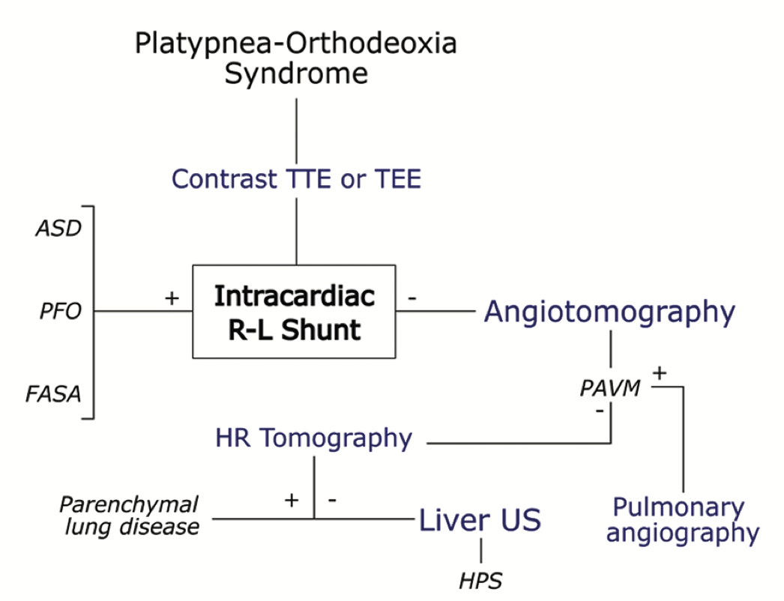
Arch Cardiol Mex. 2022 Apr 4;92(2):274-282

Slide 21
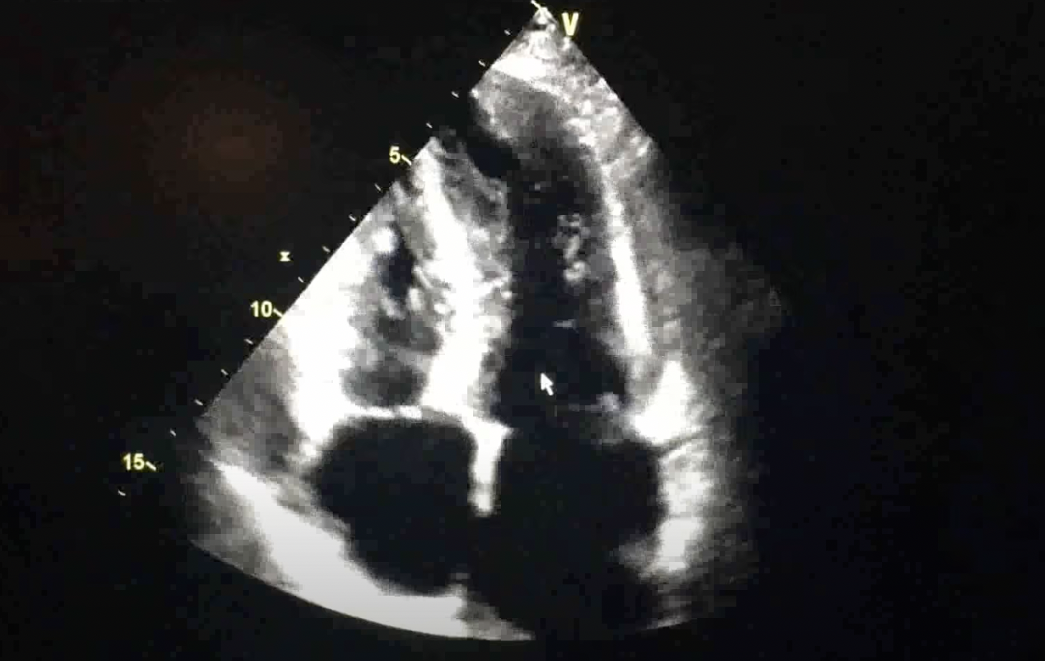
TTE with “bubble” study

Slide 22
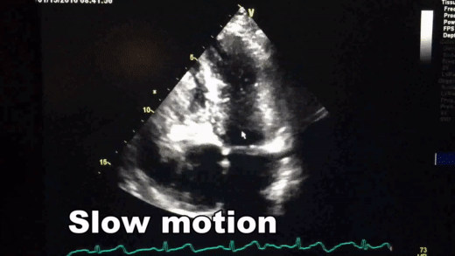

Slide 23
Diagnosis
TTE with bubble: high sensitivity
  HPS = Hypoxemia + positive bubble study + no intrinsic lung disease
In the presence of intrinsic lung disease, TTE alone is NOT sufficient to diagnose HPS
So what can we do?

Slide 24
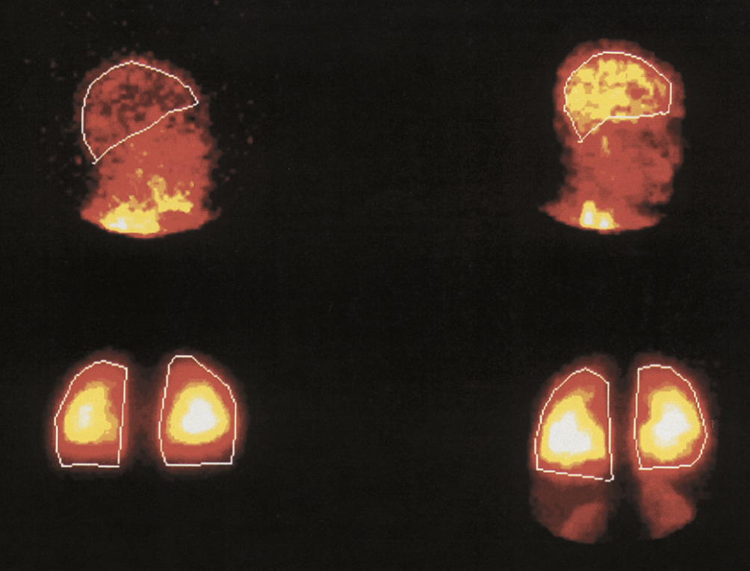
Tagged (^{99m}Tc) macroaggregated albumin (20 μm) scan

Slide 25
Diagnosis
TTE with bubble: high sensitivity
  HPS = Hypoxemia + positive bubble study + no intrinsic lung disease
In the presence of intrinsic lung disease, TTE alone is NOT sufficient to diagnose HPS
Tagged (99mTc) macroaggregated albumin (20 μm) scan:
  Highly specific but not sensitive
  Can diagnose HPS in the presence of intrinsic lung disease

Slide 26
Pulmonary Angiography
Can differentiate between type I and type II
  Type I: a diffuse spongiform appearance of pulmonary vessels during the arterial phase; and
  Type II: small discrete arteriovenous communications.
Most patients (~85%) with HPS (usually type I) have NORMAL pulmonary angiography

Slide 27
Ok, you diagnosed HPS.
How do you assess severity?
…and does it matter?

Slide 28
Severity Assessment
Obtain an ABG on room air while patient is sitting up
Severity may be influenced by the “amount of bubbles” that cross to the left side as described in the TTE
  You will see reports mentioning “large amount of bubbles”
N Engl J Med. 2008 May 29;358(22):2378-87.

Slide 29
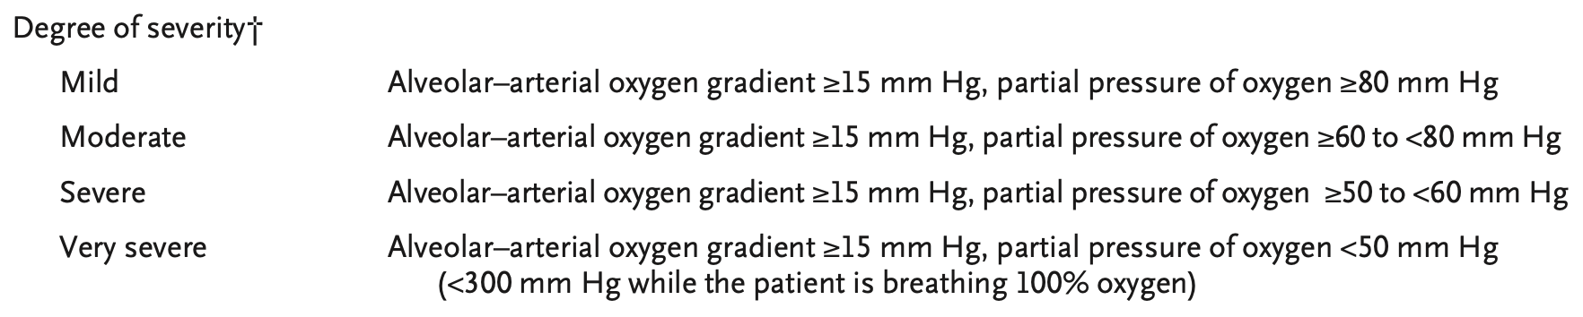
Severity Assessment
N Engl J Med. 2008 May 29;358(22):2378-87.

Slide 30
Does the degree of hepatic dysfunction or portal hypertension influence the prevalence and/or severity of HPS?

Slide 31
Does the degree of hepatic dysfunction or portal hypertension influence the prevalence and/or severity of HPS?
…controversial.

Slide 32
Treatment
No effective medical therapy exists yet
Supplemental oxygen improves quality of life (dyspnea)
Investigational therapies do exist
  TIPS: not really indicated here
  Embolization: especially type II
  Meds

Slide 33
Allium sativum

Slide 34

Allium sativum, aka garlic!

Slide 35
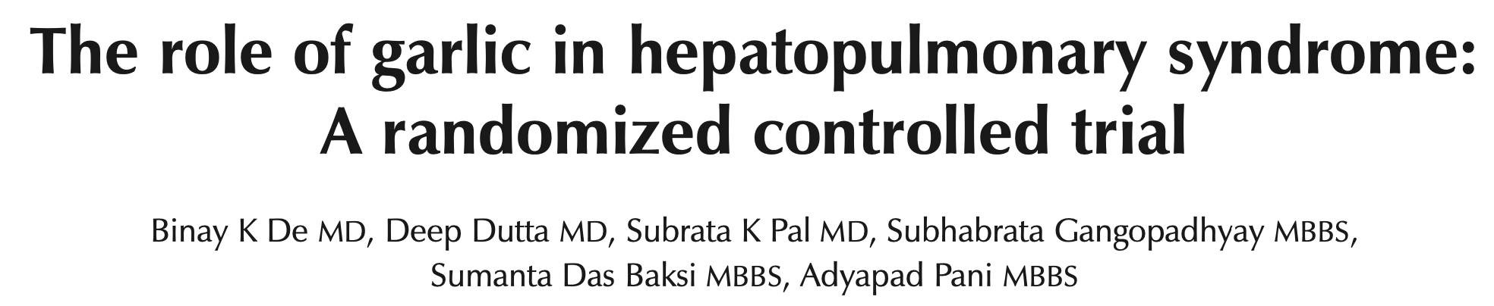
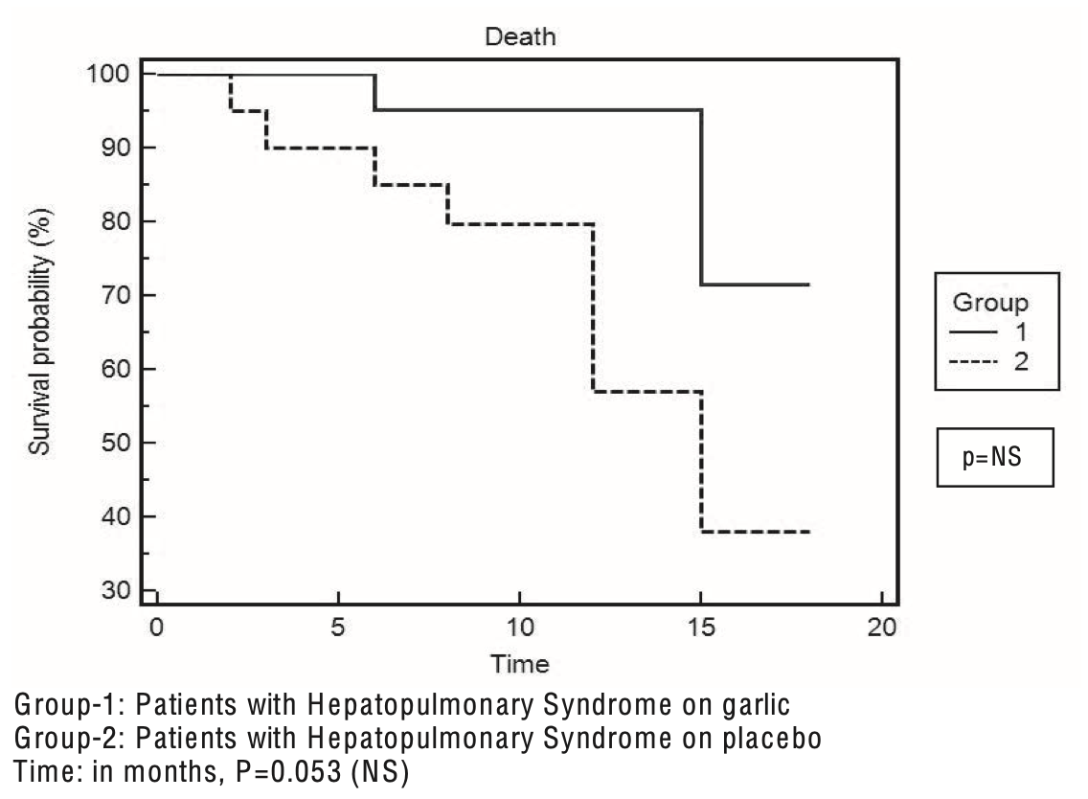
Can J Gastroenterol. 2010 Mar;24(3):183-8

Slide 36
So if you have HPS ->
O2 and chill until you die?

Slide 37
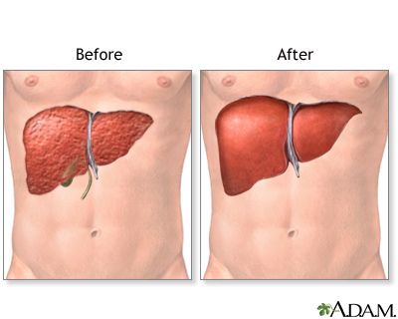
Liver Transplantation for HPS

Slide 38
Liver Transplantation for HPS
The only successful treatment for HPS
Severity of HPS influences both:
  Post operative mortality
  The interval from transplant to HPS resolution
When LTxp is curative, it takes about 6-12 months for HPS to resolve
Patients usually discharged on oxygen after transplant

Slide 39
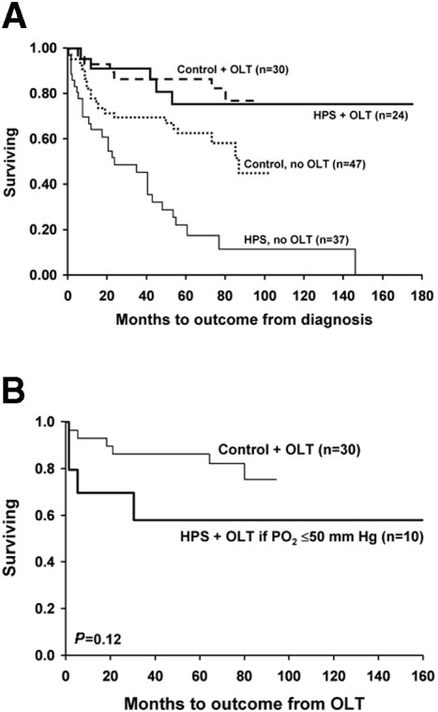
Prognosticating HPS outcomes post LT
Hepatology. 2005 May;41(5):1122-9

Slide 40
Rule of Thumb for HPS Improvement After Liver Transplant
Pre-LT: PaO2 drops roughly 0.3 to 0.4 mmHg each month in most cohorts.
Post-LT: PaO2 rises roughly 6 to 8 mmHg each month in the first year, often normalizing by 5 months.

Slide 41
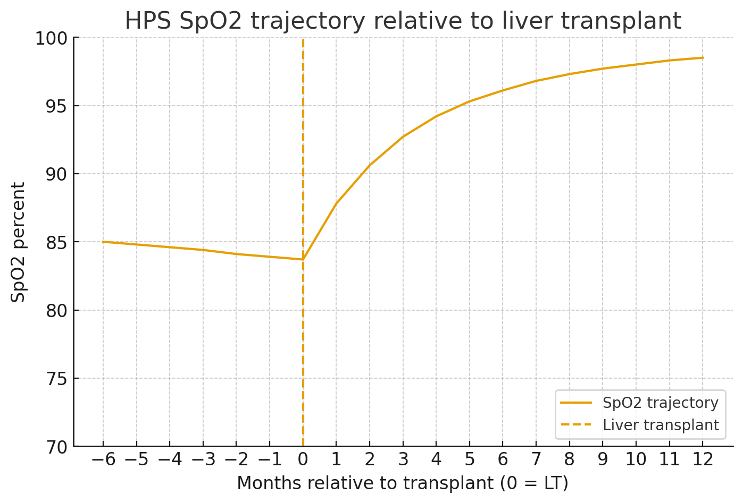

Slide 42
If transplant is curative for HPS, can anyone with HPS get a liver transplant?

Slide 43
Back to our patient 54M w/ cirrhosis and HPS
History of ascites and variceal bleeding (portal hypertension)
TTE: positive bubbles (after 4-5 cardiac cycles)
CT Chest: no intrinsic lung disease
ABG on RA: PaO2 = 55 mmHg
  Currently on 3-5L NC at home
MELD 3.0 = 10
With such low MELD, patient will not likely get a liver transplant!
What can we do?

Slide 44
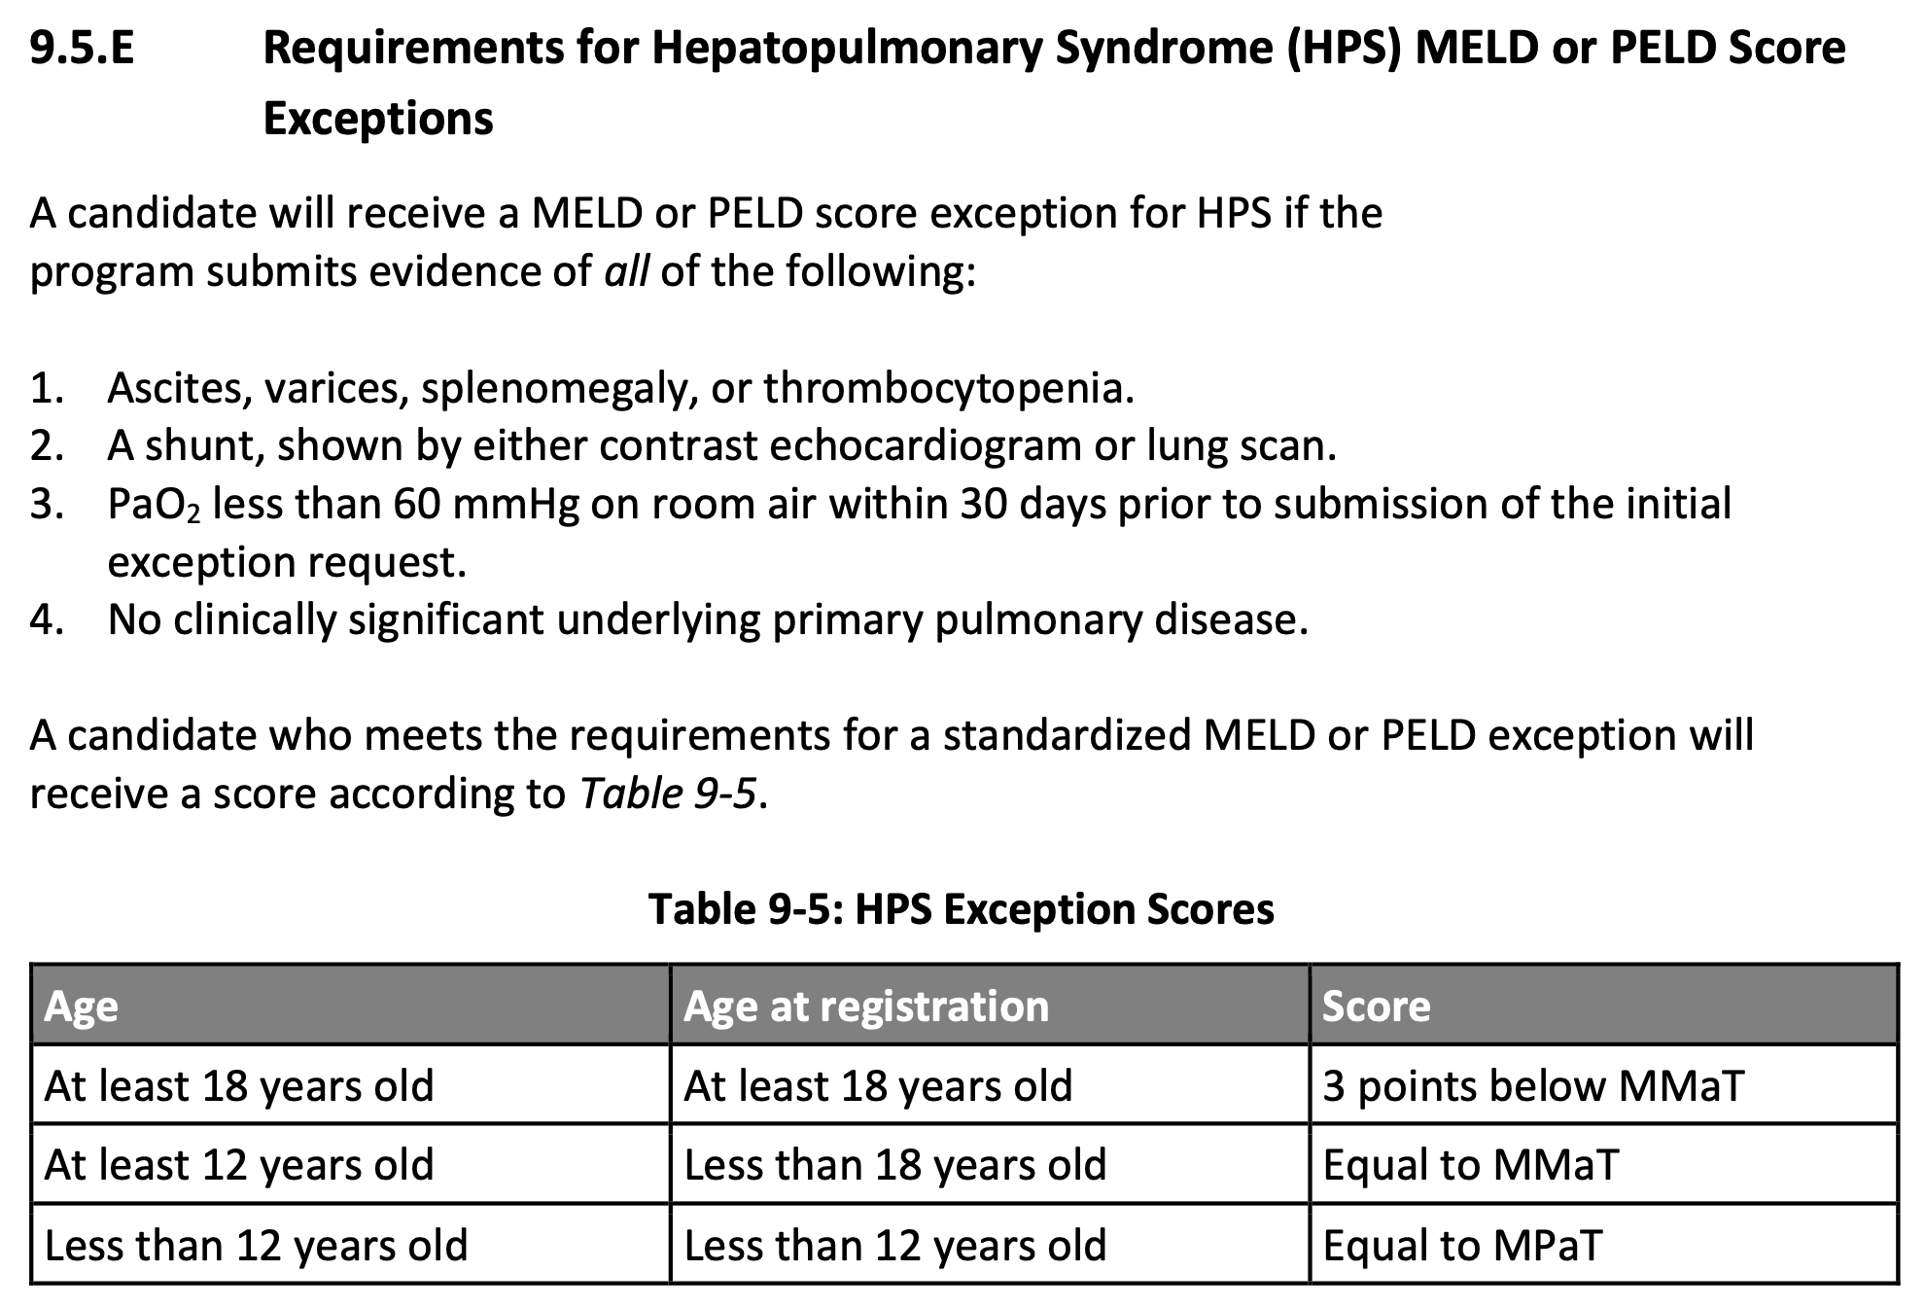
OPTN policy. Updated 1/10/2024

Slide 45
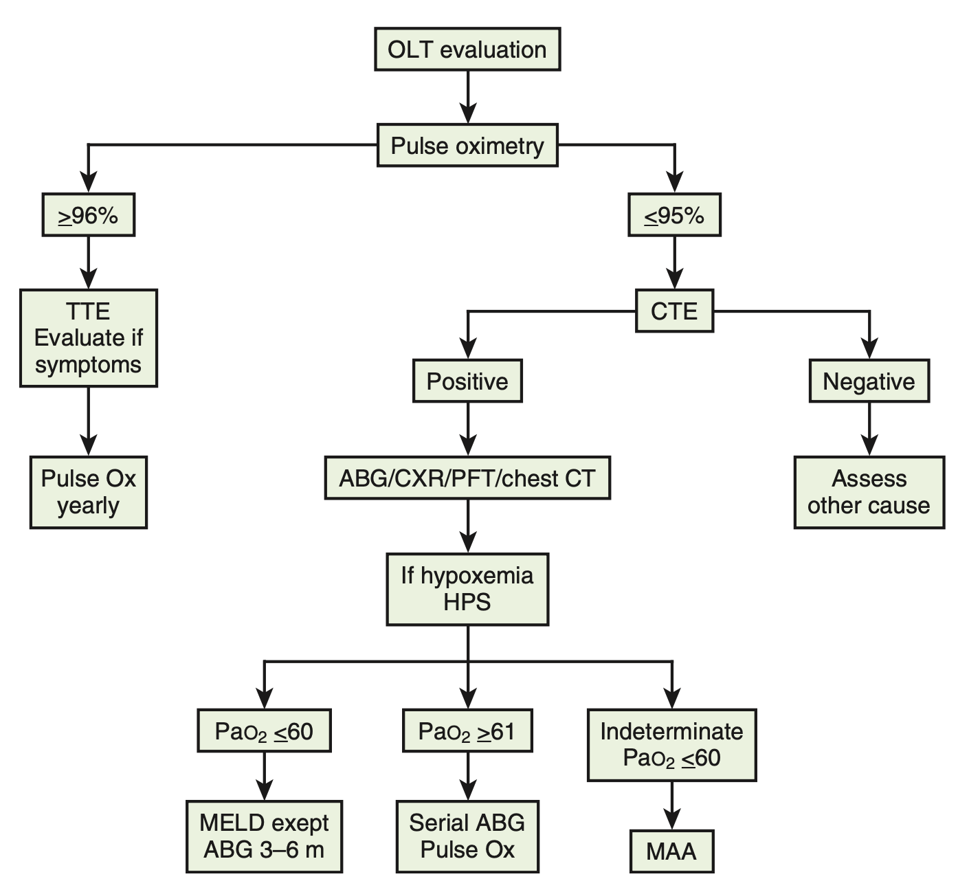
Zakim and Boyer's Hepatology, 18, 281-292.e5

Slide 46
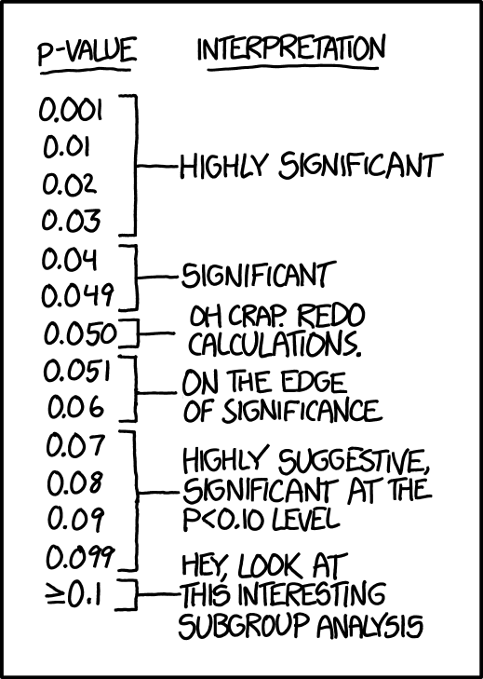
Any questions so far?

Slide 47
Case Presentation
A 52-year-old woman with history of MASLD cirrhosis complicated by ascites, presents with exertional dyspnea, underwent a TTE that showed an RVSP of 45.
What’s your next step?

Slide 48
Right Heart Catheterization
RA 15 mmHg
RV 60/30 (40) mmHg
PA 65/40 (48) mmHg
PCWP 10 mmHg
PVR 500 dynes
PVR 6.25 woods units (WU)

Slide 49
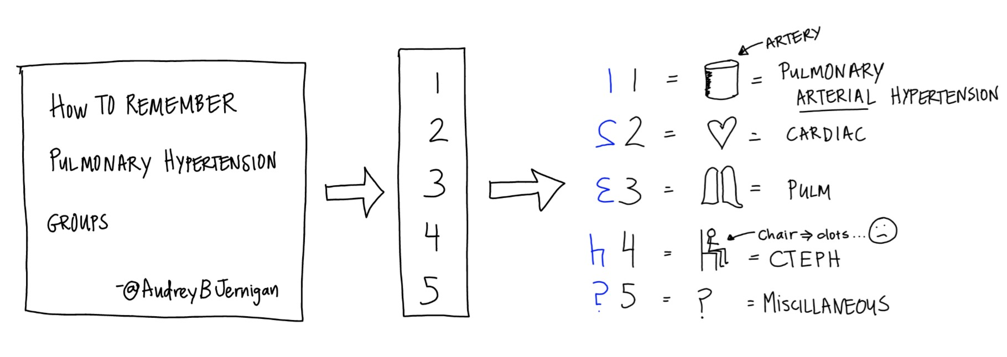

Slide 51
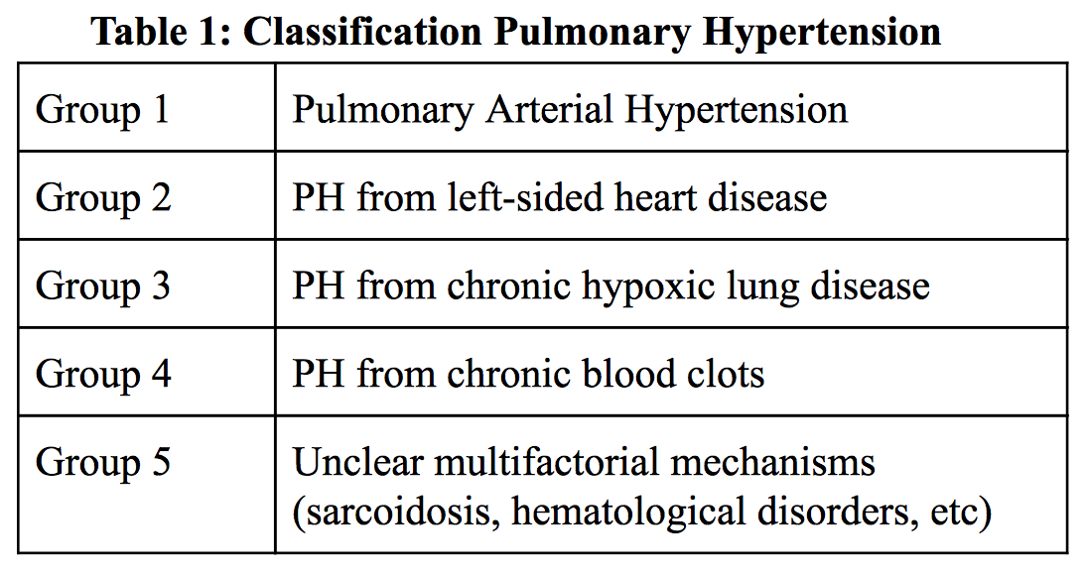
Which one of the above is portopulmonary hypertension?

Slide 52
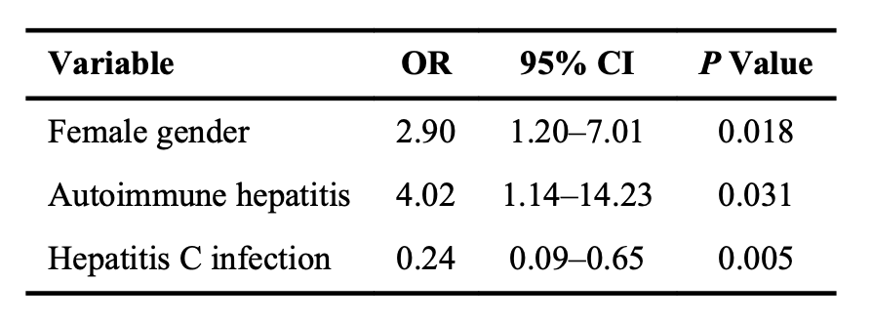
Portopulmonary Hypertension
The prevalence varies between 2-10% of patients with portal hypertension, depending which study you look at
Hepatology. 2008 Jul;48(1):196-203

Slide 53
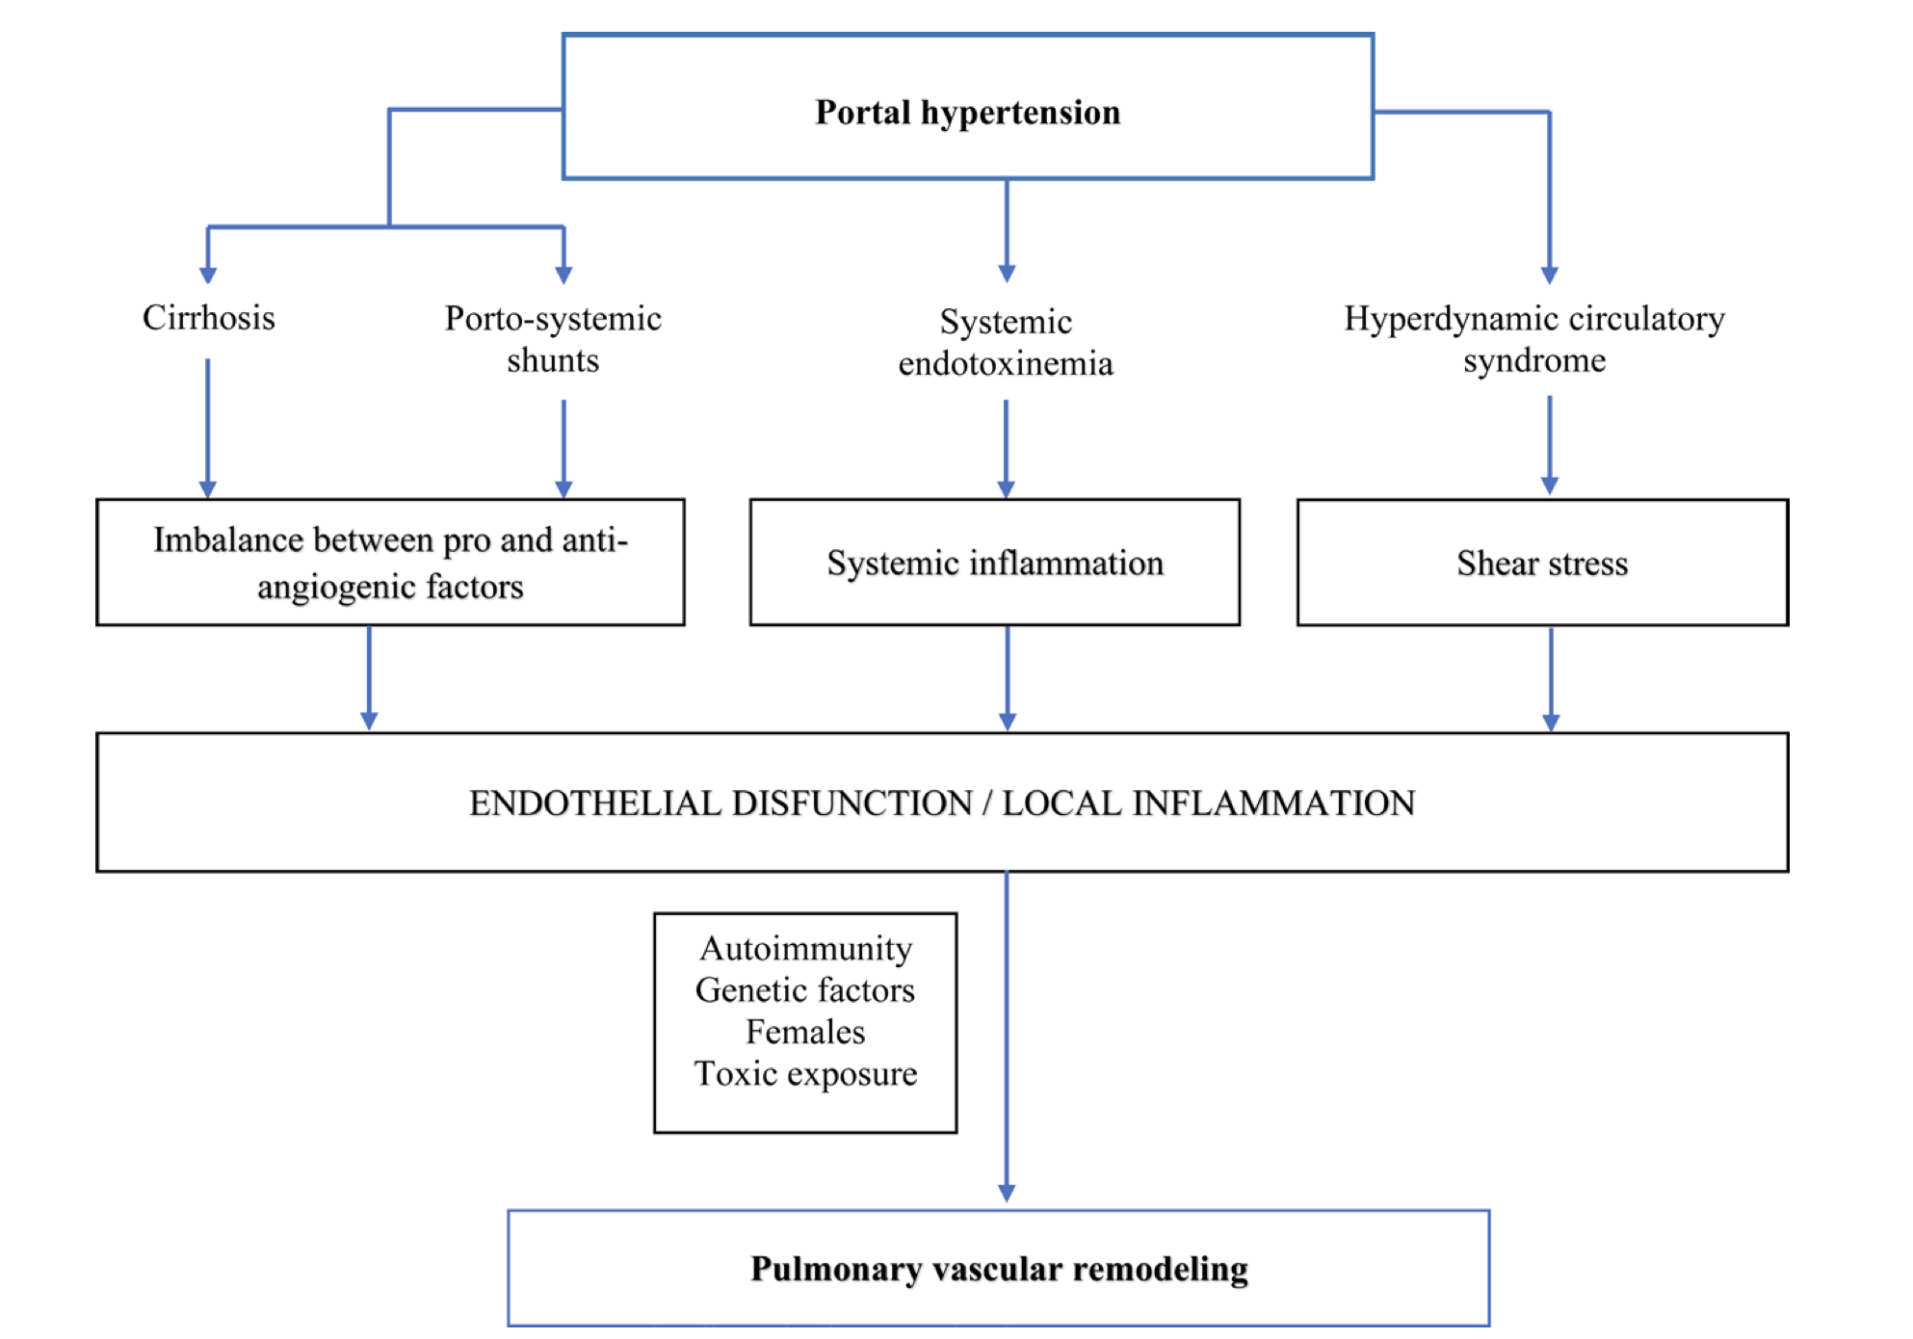
Transplant Direct. 2023 Jul 21;9(8):e1517

Slide 54
Portopulmonary Hypertension
For proper diagnosis, you will have to rule out other causes of pulmonary hypertension (i.e. rule out all other groups)
Not necessarily, but most patients tend to get
  CT Chest (r/o intrinsic lung disease)
  V/Q Scan (r/o CTEPH)

Slide 55
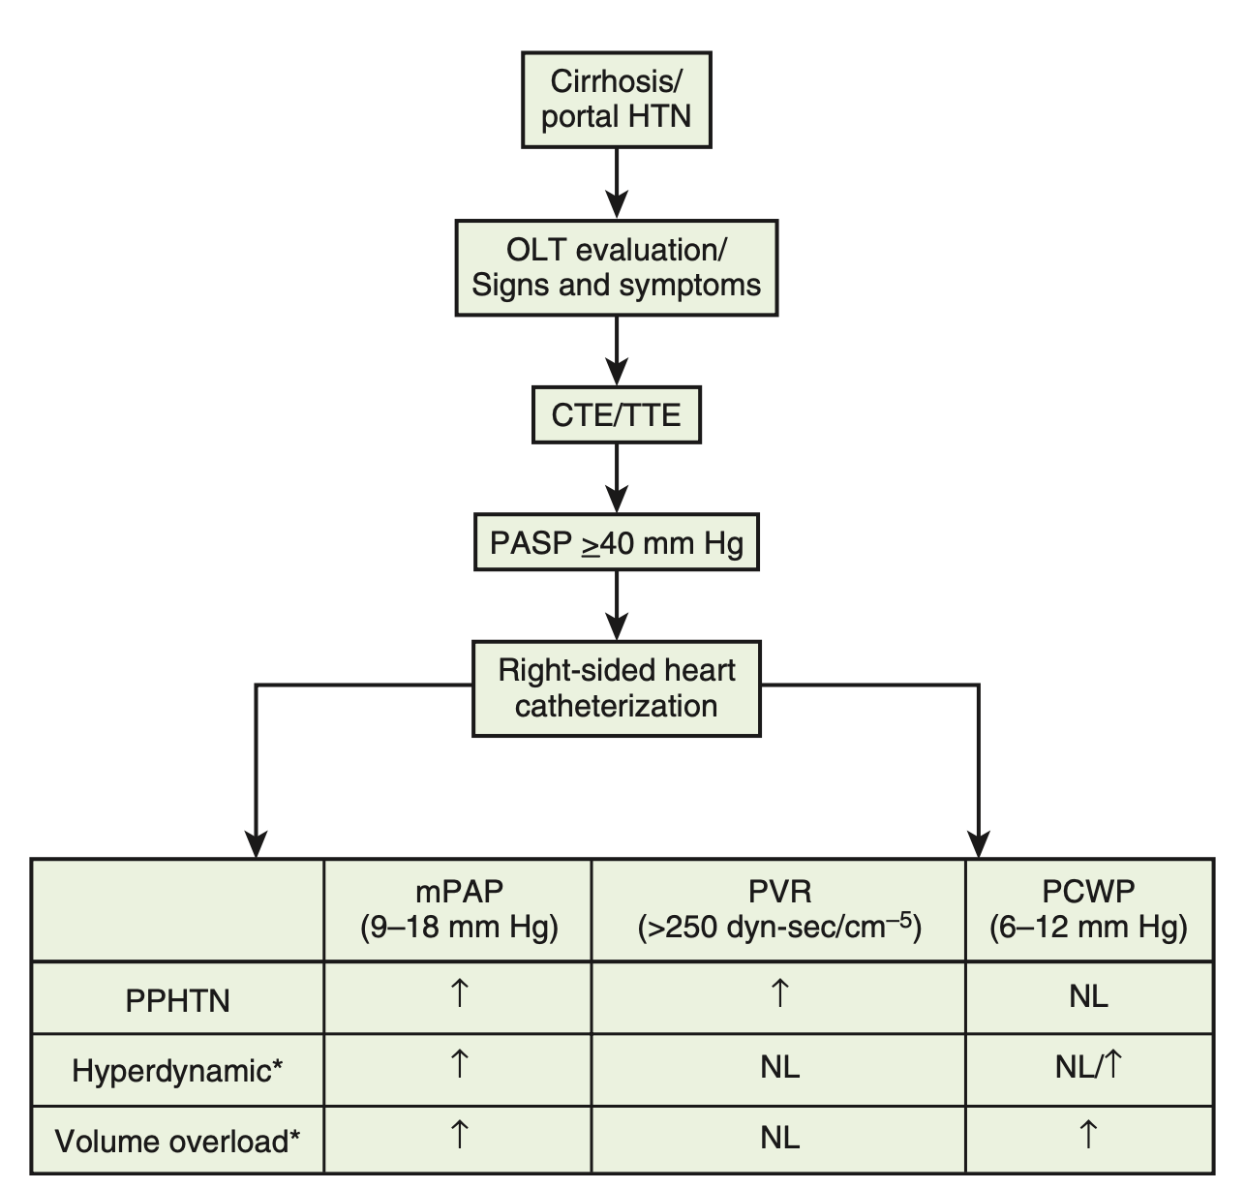
Zakim and Boyer's Hepatology, 18, 281-292.e5

Slide 56
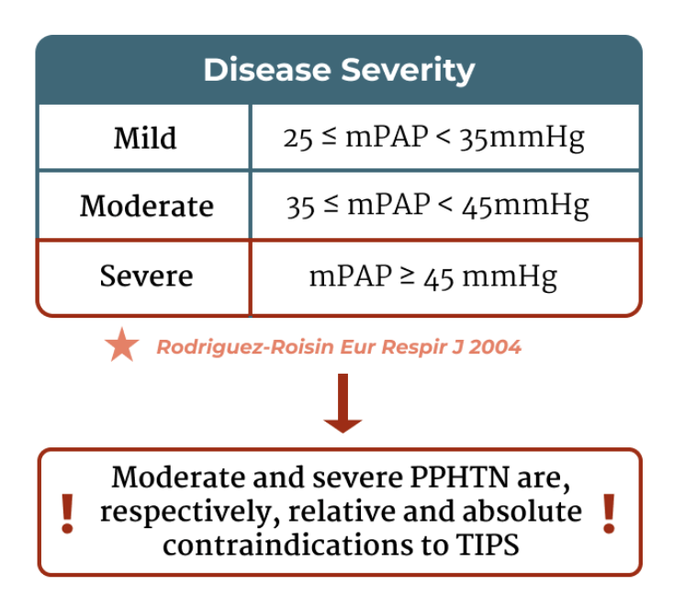
Liver Fellow Network - Quick Tips: Portopulmonary Hypertension

Slide 57
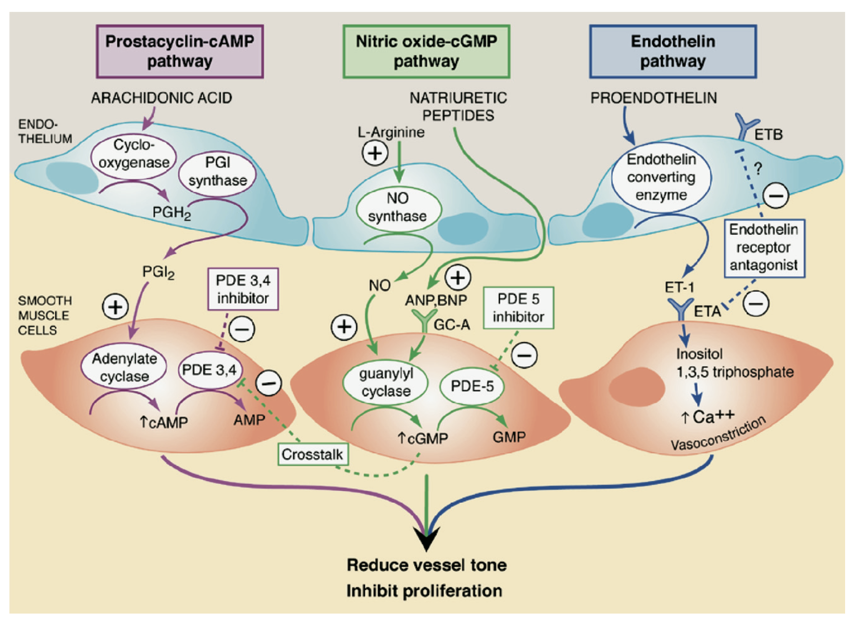
J Heart Lung Transplant. 2007 May;26(5):437-46

Slide 58
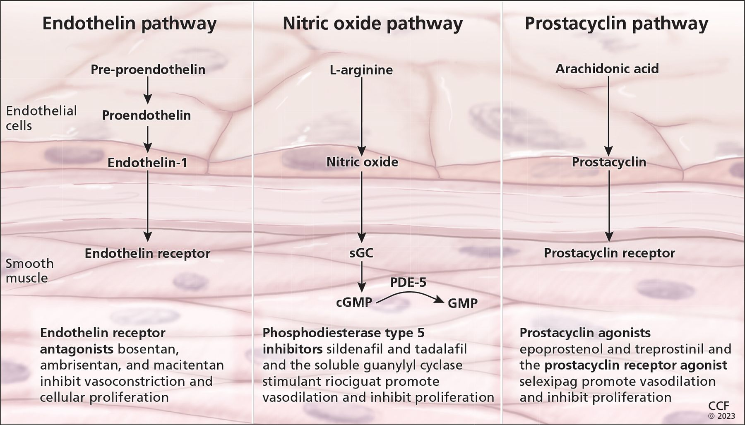
Cleve Clin J Med. 2023 Oct 2;90(10):632-639

Slide 59
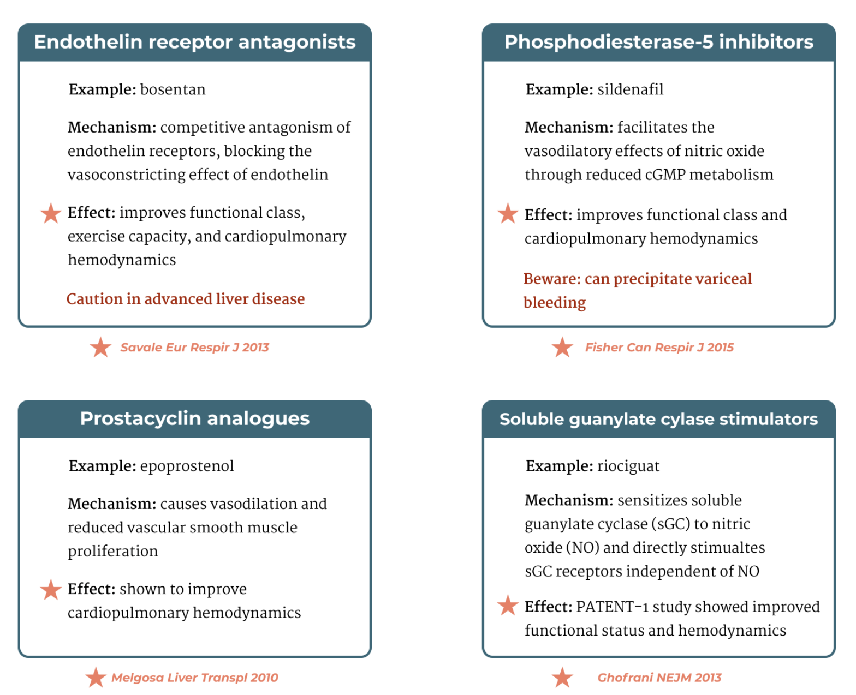
Liver Fellow Network - Quick Tips: Portopulmonary Hypertension

Slide 60
Do these therapies improve mortality?
Any other therapy in your mind?

Slide 61
How about TIPS?

Slide 62
How about TIPS?
Bad idea.

Slide 63
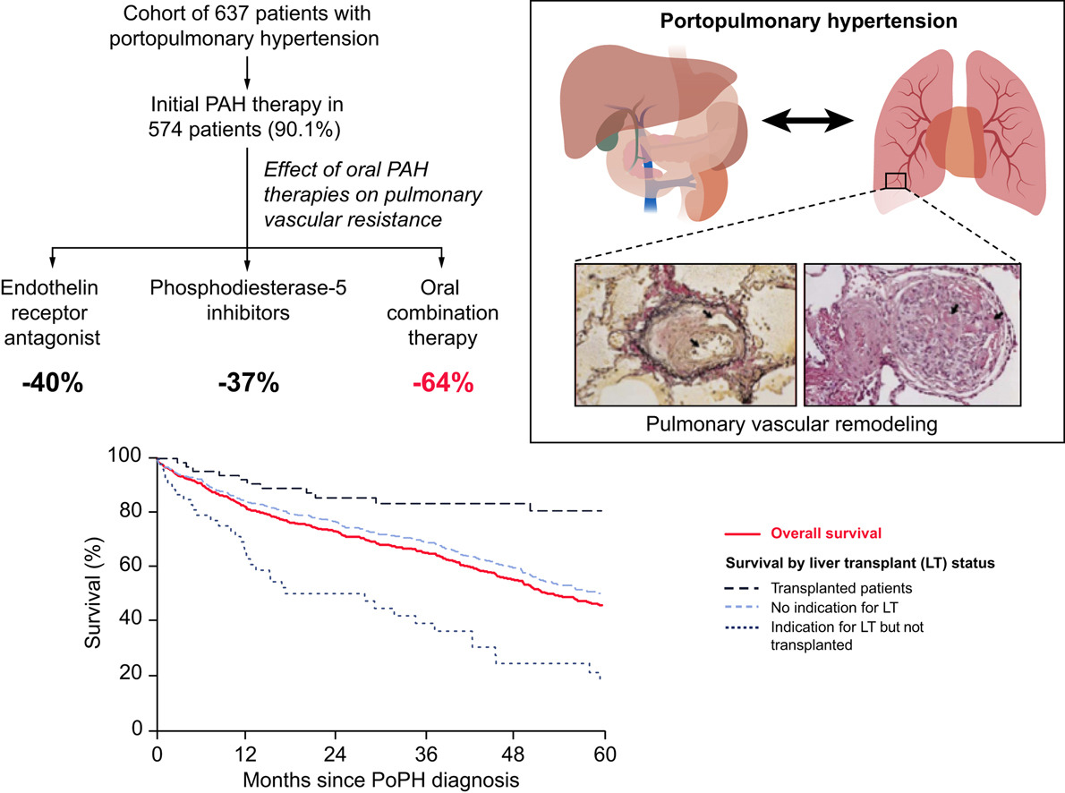
Curr Hepatol Rep. 2020 Sep;19(3):174-185

Slide 64
What happens if we transplant patients with severe (porto)pulmonary hypertension?
mPAP>50

Slide 65
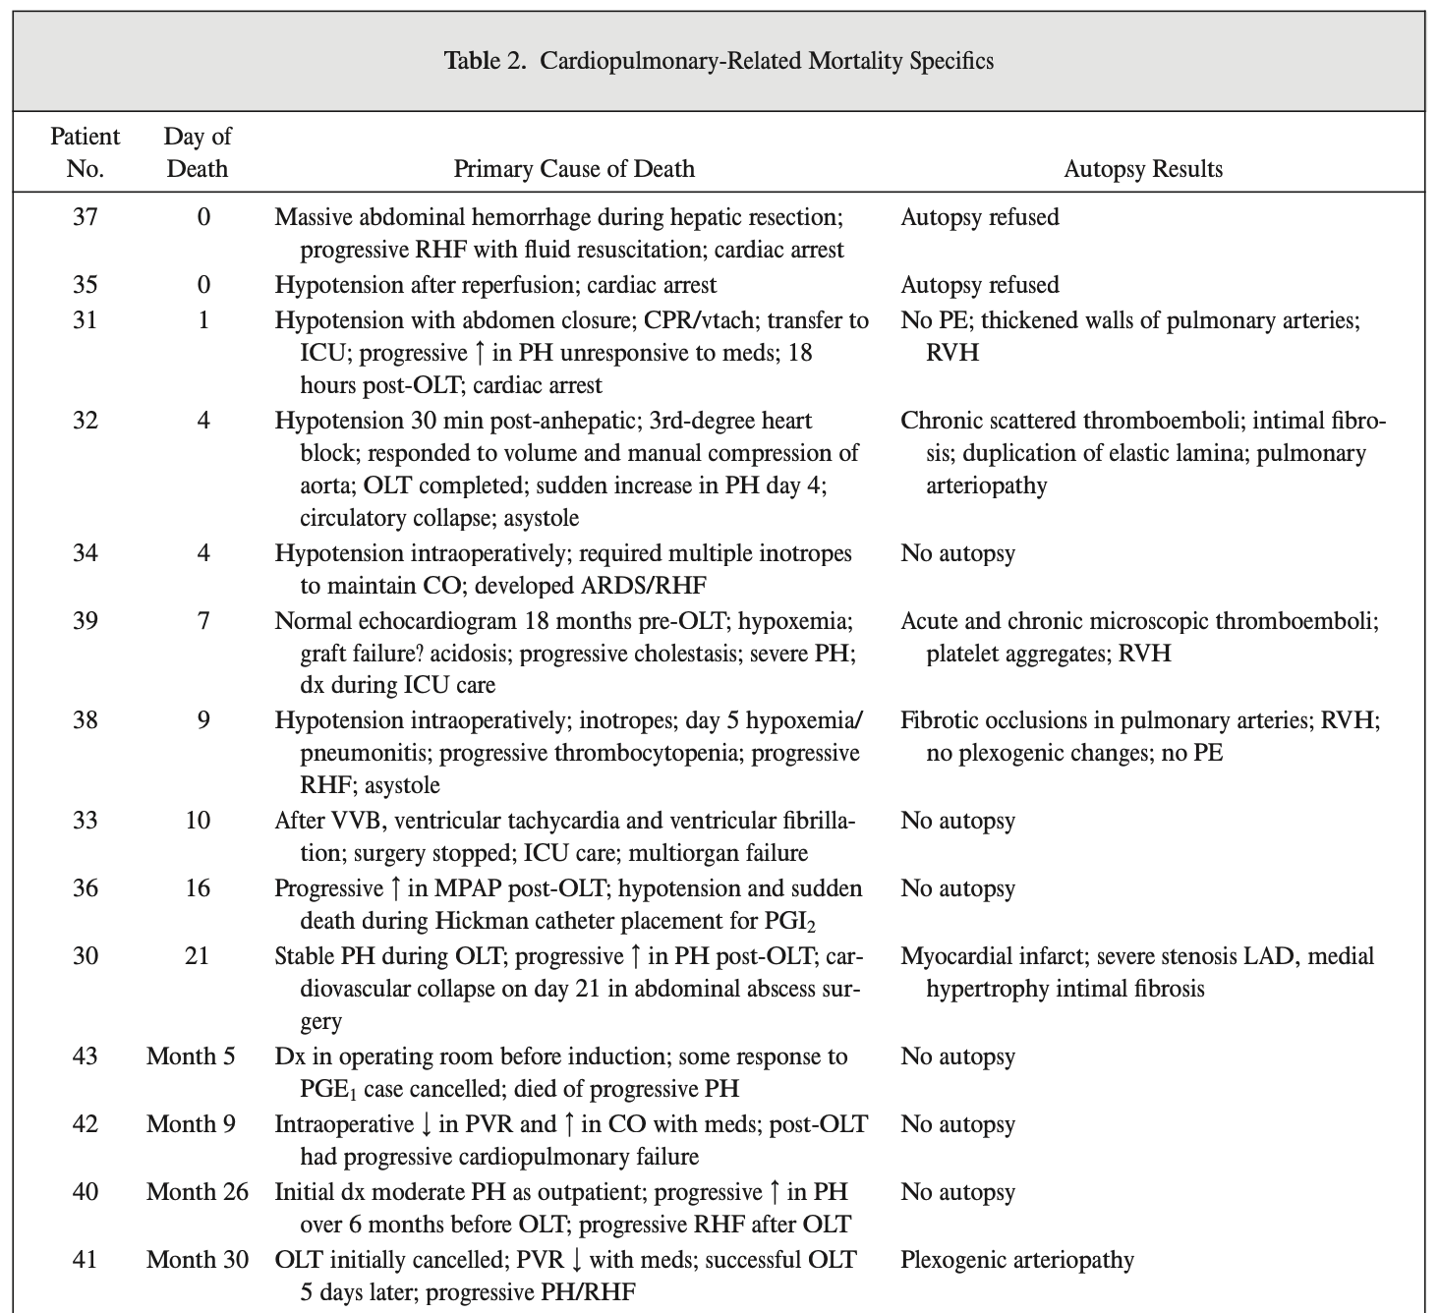
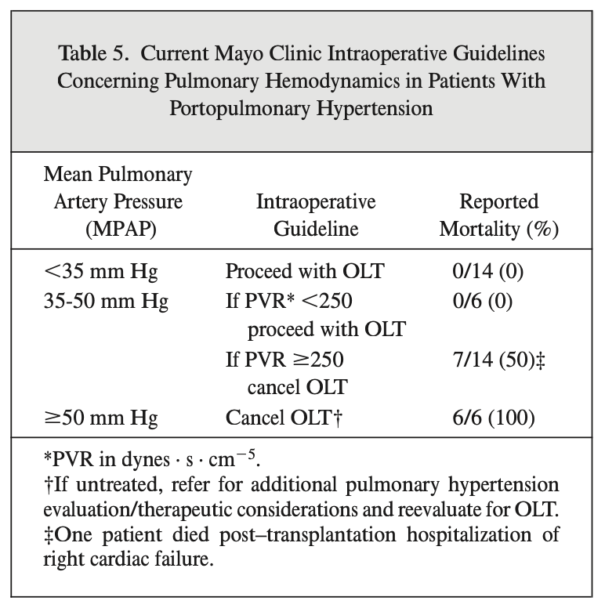
Liver Transpl. 2000 Jul;6(4):443-50

Slide 66
How about if you survive the liver transplant?

Slide 67
Improvement of POPH After Liver Transplant
100% (14/14) of patients on parenteral therapy were able to discontinue prostacyclin therapy.
  The median time from transplant date to discontinuing parenteral therapy was 7.2 months (IQR: 5.1–8.9 mo).
61.9% (13/21) of surviving patients were able to stop all pulmonary vasodilator therapy posttransplant
  Median time of 13.9 months (IQR: 5.1–17.6 mo).
Transplantation. 2021 Feb 1;105(2):346-353

Slide 68
What do the Guidelines Say?
“Importantly, LT is not a cure for all patients with POPH and only half of patients are able to safely discontinue PH therapy”
Treatment de-escalation is a process that should not be rushed
  Parenteral prostacyclin analogues weaned first
  Oral and inhaled PAH meds may be stopped eventually
Periodic TTE +/- RHC should be used to follow POPH post-transplant
International Liver Transplantation Society practice guideline update on portopulmonary hypertension. Liver Transpl. 2025 Mar 18. doi: 10.1097/LVT.0000000000000600

Slide 69
Back to our patient
A 52-year-old woman with history of MASLD cirrhosis complicated by ascites, presents with exertional dyspnea, and RHC showing mPAP 48 mmHg, and PVR 500. CT chest wnl, and V/Q wnl.
MELD 3.0 = 10
With such low MELD, even if listed for transplant, the wait time will be prolonged.
Anything we can do?

Slide 70
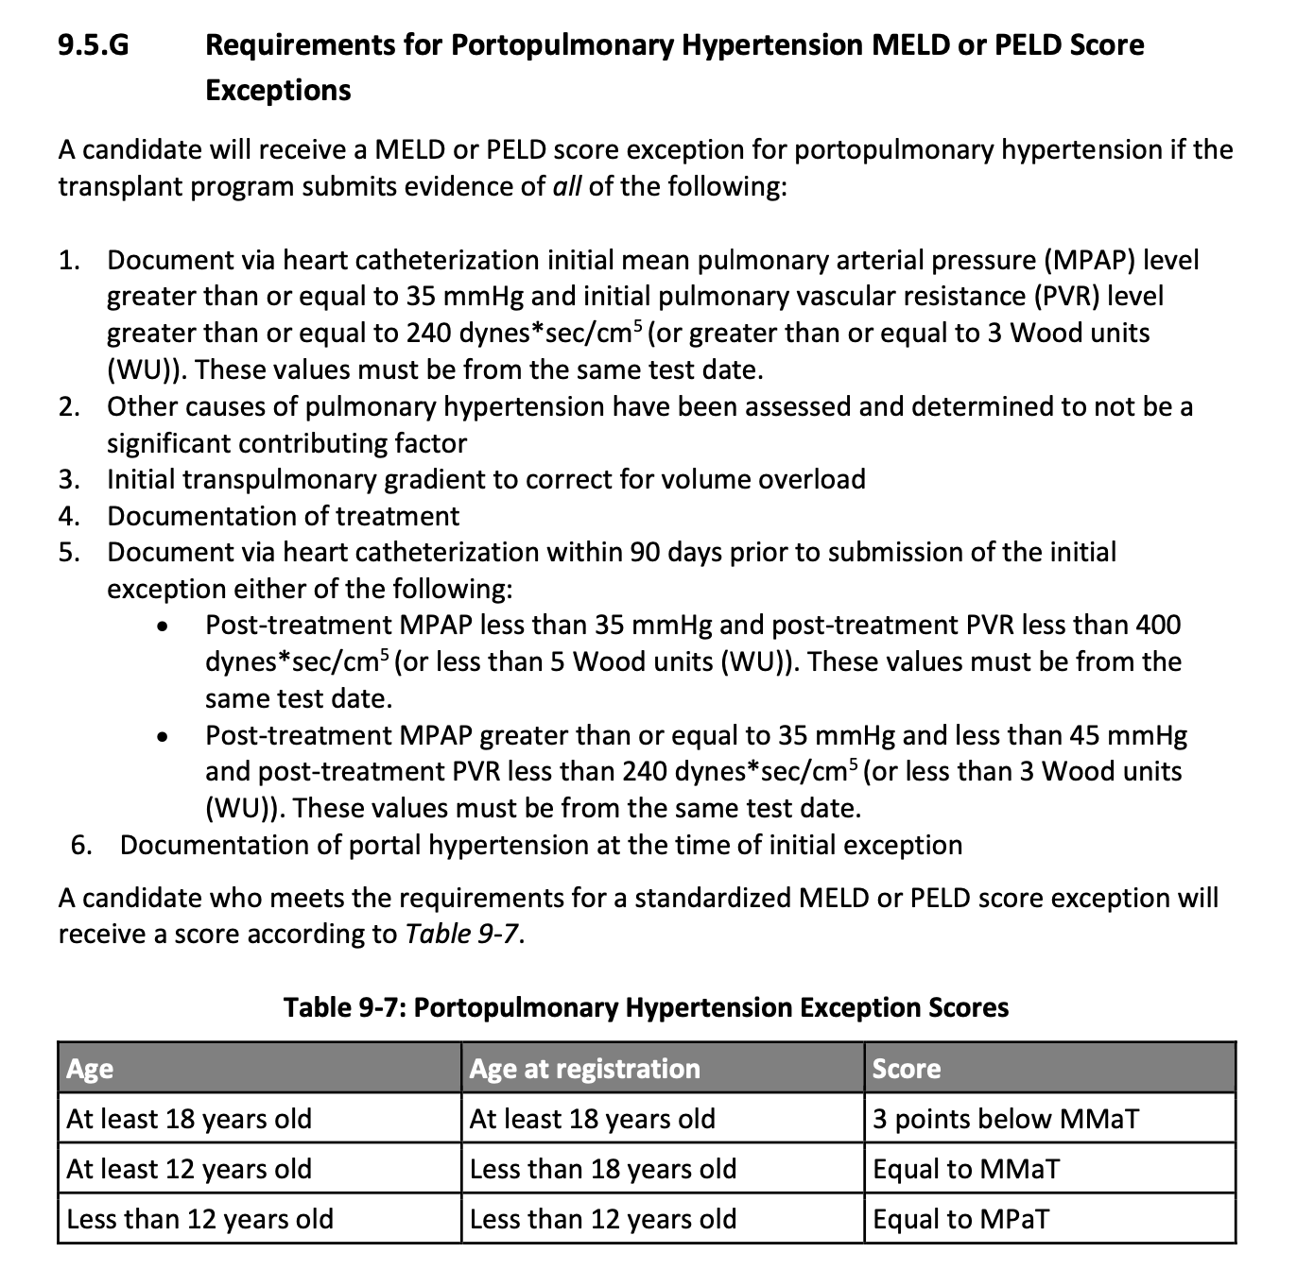

Slide 71
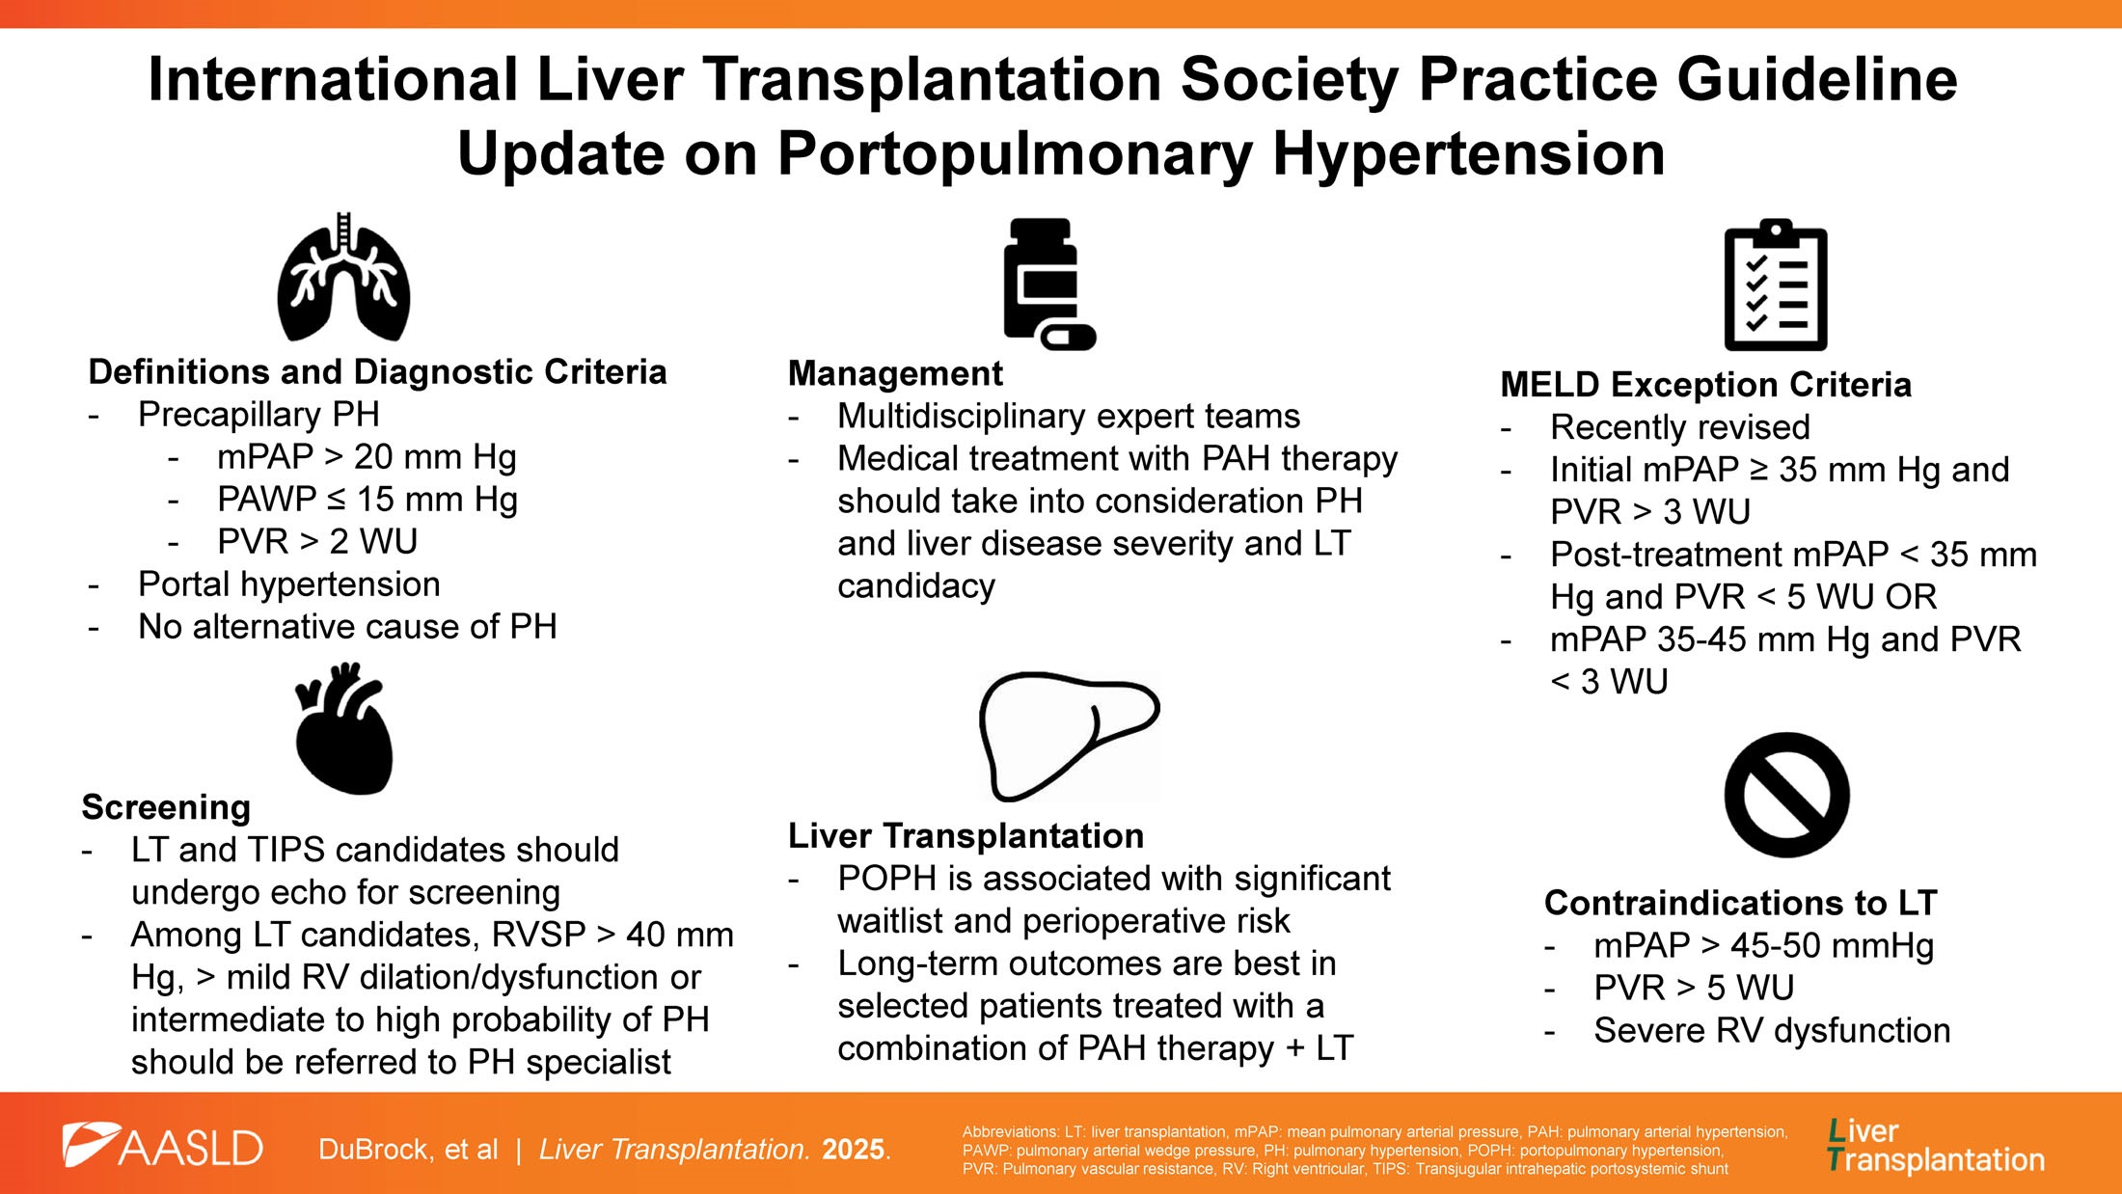

Slide 72
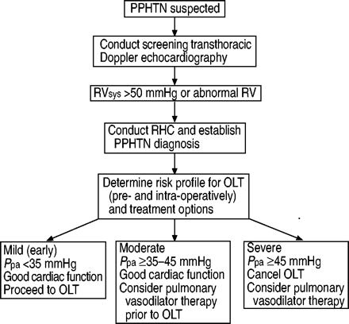
Eur Respir J. 2004 Nov;24(5):861-80

Slide 73
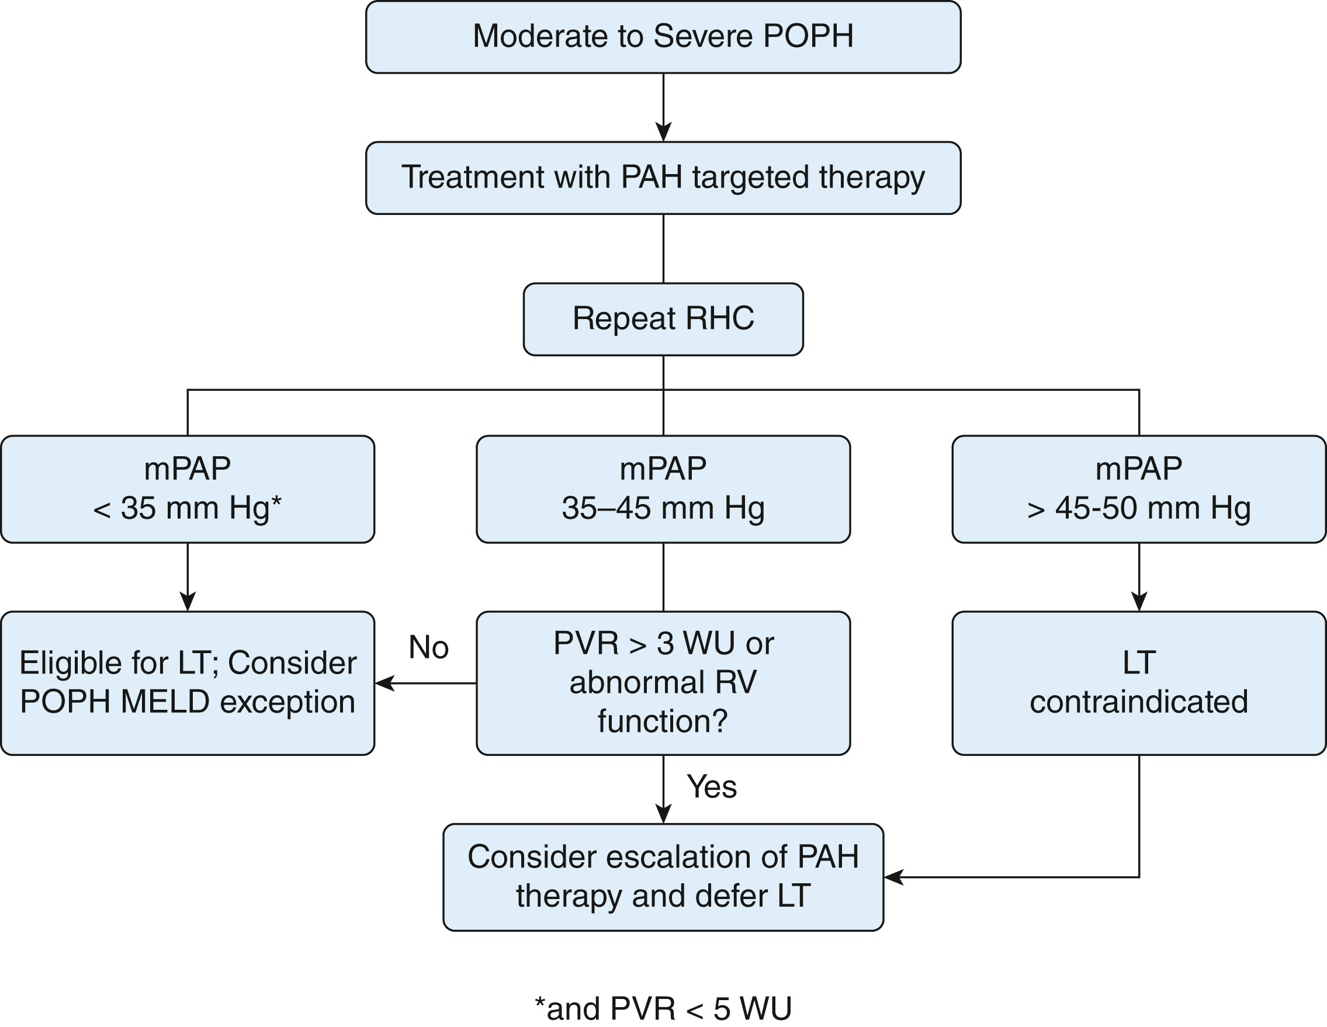
Chest. 2023 Jul;164(1):206-214

Slide 74
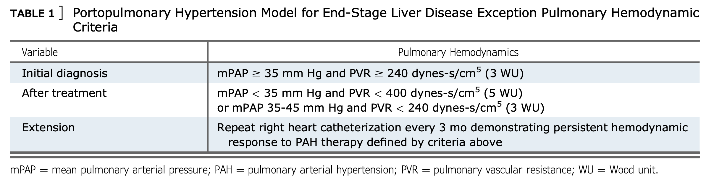
Chest. 2023 Jul;164(1):206-214

Slide 75
Take home points
Hepatopulmonary syndrome = intrapulmonary R->L shunt -> dx with TTE + bubble
No medical therapy exists for HPS yet
Portopulmonary hypertension = Group 1 PAH -> dx w/ TTE+RHC
Medical therapy until response (mPAP < 45)
Severe pulmonary hypertension is a contraindication to LTxp
Both have strict criteria foe MELD Exception Points
Co-managed with hepatology and pulmonary

